Slide 1
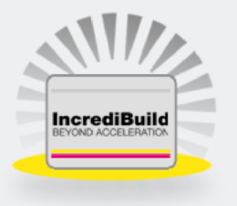

Distributed Build : Using Incredibuild
Distributed Build - Incredibuild
Worried With ??
    Software build process time
    Unit Test time
    QA Script
    Rendering
    Encoding
    Etc..
Here is the remedy
40 Min
Commercial solution for a faster software build
ECA | 12/21/2015 | © Robert Bosch Engineering and Business Solutions Private Limited 2015. All rights reserved, also regarding any disposal, exploitation, reproduction, editing, distribution, as well as in the event of applications for industrial property rights.

Slide 2
Incredibuild : Tool Overview
Distributed Build - Incredibuild
ABOUT
INCREDIBUILD
  Is an external tool which accelerates build time through efficient parallel computing
  Processes are distributed to remote CPU resources for parallel processing, dramatically shortening build time up by to 90% or more
PURPOSE
  Reduce the over all software build time to 10 times faster than the existing build time
  Shortening the project life cycle and reducing development cost
  Increase the developer productivity
PREREQUISITES
  64 bit Ubuntu 12.04LTS version
  Sufficient number of compiler licenses for build ( open source license used for evaluation)
BENEFITS
With Incredibuild
Build Time Reduction
 Up to 80%
Asset Utilization
 100%
Productivity

ECA | 12/21/2015 | © Robert Bosch Engineering and Business Solutions Private Limited 2015. All rights reserved, also regarding any disposal, exploitation, reproduction, editing, distribution, as well as in the event of applications for industrial property rights.

Slide 3

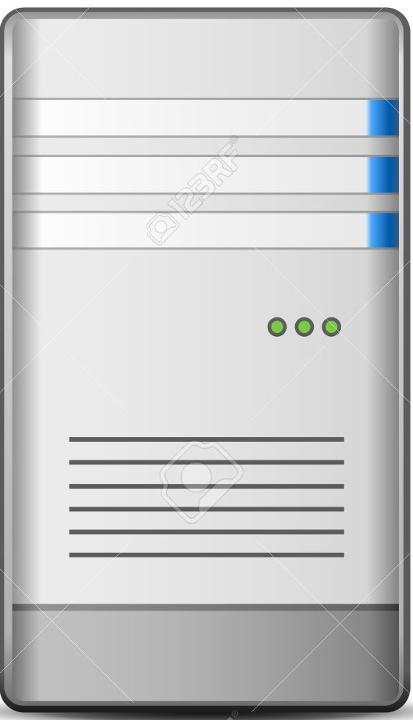
Incredibuild Build Setup
Distributed Build - Incredibuild
Dedicated Cloud Setup
Incredibuild Monitor Build results via Web Server
Incredibuild agent machines
BCN
BCN
Developer
machines
. . . .
. . . .
Coordinator machine
ECA | 12/21/2015 | © Robert Bosch Engineering and Business Solutions Private Limited 2015. All rights reserved, also regarding any disposal, exploitation, reproduction, editing, distribution, as well as in the event of applications for industrial property rights.

Slide 4

Incredibuild Build Setup
Distributed Build - Incredibuild
Virtual Cloud Setup
Incredibuild Monitor Build results via Web Server
BCN
Developer machines
with
Incredibuild Agents in with allocated cores
Coordinator machine
. . . .
ECA | 12/21/2015 | © Robert Bosch Engineering and Business Solutions Private Limited 2015. All rights reserved, also regarding any disposal, exploitation, reproduction, editing, distribution, as well as in the event of applications for industrial property rights.

Slide 5
Build Result With Incredibuild
Distributed Build - Incredibuild
License Cost :
Build Type | License Cost Per Core ($) | 36 cores setup License cost for 1 Year ($)
Developer Build (<20 build/day) | 15 | 527
Build Server (>20 build/day) | 25 | 527
5 to 17 Times Faster Build
Infrastructure Cost :
Infrastructure | P500 Machine Cost ($) | 36 cores cloud setup cost ($)
Static Cloud Setup | 1500 | 7500
Virtual Cloud Setup | 1500 | 1500
Build Time
CPU Cores Used
P500 Machine is taken for example, cloud setup can be done with any System with requirement of 2GB RAM per core
ECA | 12/21/2015 | © Robert Bosch Engineering and Business Solutions Private Limited 2015. All rights reserved, also regarding any disposal, exploitation, reproduction, editing, distribution, as well as in the event of applications for industrial property rights.

Slide 6
Features Supported
Distributed Build - Incredibuild
Incredibuild tool has potential to accelerate the overall delivery processes to a new level of performance. Ensures faster time to market and increased productivity
Accelerable Steps
Code generation
Code compilation
Unit Testing
QA Scripts
Static/Dynamic Code analysis
Stress Tests
Code Verification
Code obfuscation
Compression/Decompression
Packaging
Tools Integrated
Jenkins - Many ALM steps performed by Jenkins can be accelerated
ECA | 12/21/2015 | © Robert Bosch Engineering and Business Solutions Private Limited 2015. All rights reserved, also regarding any disposal, exploitation, reproduction, editing, distribution, as well as in the event of applications for industrial property rights.

